Slide 1
simple_overlay.conf
This is the topology provided with the starter code.
2
127.0.0.15020
cost = 1
cost = 1
1
127.0.0.15010
4
127.0.0.15040
3
127.0.0.15030
cost = 1
cost = 1

Slide 2
simple_overlay2.conf
Shows 2 non-equal-cost paths between 1 and 4.
Shows 2 equal-cost paths between 2 and 3
2
127.0.0.15020
cost = 1
cost = 1
1
127.0.0.15010
4
127.0.0.15040
3
127.0.0.15030
cost = 2
cost = 2

Slide 3
lecture_topo.conf
See link-state routing slides from lecture 14 for example shortest path computations and forwarding tables with this topology
5
2
3
3
2
5
1
2
1
6
3
1
2
4
5
1

Slide 4
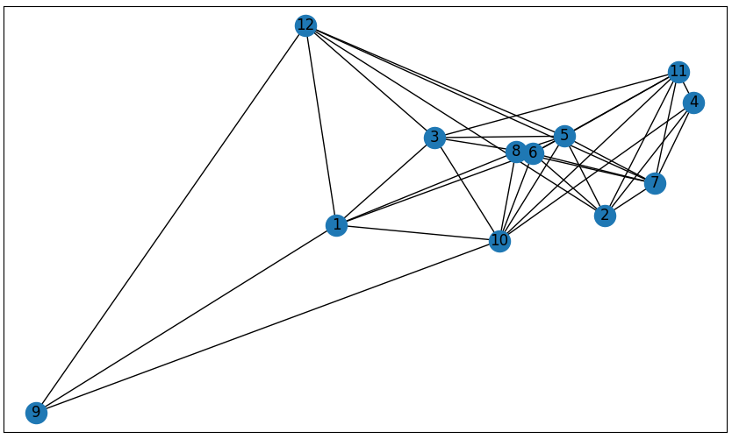
us_topo.conf
A fairly realistic topology spanning the US based on GENI nodes

